Slide 1

Sri Venkateswara College of engineering and technology
(Automomous)
R.V.S Nagar, Chittoor-517 127.(A.P)
B.Tecg - Computer Science and engineering(AI&ML)
Academic Year:2025-2026
Project Title:
AI POWERED CAREER INTELLIGENCE
By: M.Vani(22781A3387)
P.Yaswitha(22781A33A0)
S.Govardhan Reddy(22781A33B3)
T.Brahmaiah(22781A33D0)
P.Sudheer(23785A3316)
Submitted By:
Under the Guidance of
Dr.M.Layanya(Department of CSE(AI&ML)

Slide 2
ABSTRACT
The rapid growth of the job market and continuous changes in industry requirements make it difficult for job seekers and organizations to accurately understand employment demand trends. Traditional job analysis methods are often manual, time-consuming, and fail to adapt to dynamic market conditions. This project focuses on developing a Job Demand Prediction System using machine learning techniques to analyze historical job market data and predict future demand across different job roles and industries.
The proposed system utilizes structured datasets containing features such as job roles, required skills, experience levels, locations, and hiring trends. Machine learning models, including ensemble-based algorithms, are applied to identify hidden patterns and relationships within the data. In addition, rule-based logic is integrated to enhance interpretability and support decision-making under specific business constraints.
The system provides demand predictions through a user-friendly web interface, enabling users to explore job trends and make informed career or recruitment decisions. By offering data-driven insights into job demand patterns, the proposed solution helps job seekers plan their skill development effectively and assists organizations in workforce planning, thereby improving the overall efficiency and reliability of job market analysis.

Slide 3
AGENDA
Introduction
Problem Statement
Existing Job Market Analysis System
Proposed Job Demand Prediction System
System Architecture
Methodology
Implementation
Experimental Setup & Results
Applications
Future Scope
Conclusion

Slide 4
1. INTRODUCTION
The job market is continuously evolving due to rapid technological advancements, globalization, and changing industry requirements. Job seekers and organizations often face difficulties in understanding current and future demand for specific job roles and skills. Traditional job market analysis methods are mostly manual and static, making them ineffective in capturing dynamic hiring trends and emerging skill requirements.
With the increasing number of online job portals and recruitment platforms, a large volume of job-related data is generated every day. However, without intelligent analysis, this data cannot be effectively utilized to support career planning and workforce management. Existing systems mainly provide descriptive statistics and historical information, which may not accurately reflect future job demand patterns.
To address these challenges, there is a strong need for an intelligent system that can analyze historical job market data and predict future demand accurately. Machine learning techniques offer an effective solution by identifying patterns, trends, and relationships within large datasets. The proposed Job Demand Prediction System leverages these techniques to provide reliable demand forecasts, helping job seekers make informed career decisions and assisting organizations in strategic workforce planning.

Slide 5
2. PROBLEM STATEMENT
The job market operates in a highly dynamic environment where employment demand is influenced by factors such as technological advancements, industry growth, geographical location, skill requirements, and economic conditions. Existing job market analysis systems mainly rely on static reports and historical summaries, which fail to capture real-time changes and emerging trends accurately.
Most traditional systems do not effectively analyze large volumes of job posting data or consider multiple influencing factors simultaneously, resulting in unreliable or outdated demand insights. As a consequence, job seekers face uncertainty in choosing suitable career paths, while organizations struggle with inefficient workforce planning and talent acquisition.
Therefore, there is a need for an intelligent, data-driven system that can analyze historical job market data and predict future demand for various job roles and skills. Such a system should provide accurate, interpretable, and timely predictions to support informed decision-making for both job seekers and recruiters.

Slide 6
EXISTING SYSTEM
Provides only static job listings and historical reports
Job demand insights are based on past data, not future trends
No prediction of job demand or hiring growth is available
Does not effectively use machine learning or advanced analytics
Limited consideration of factors like skills evolution, location, and industry trends
Job seekers cannot clearly understand future demand for specific roles
LIMITATIONS OF EXISTING SYSTEM
Cannot predict future job demand levels
Ignores rapid changes in technology and market requirements
Does not analyze large-scale job posting data effectively
Demand insights are often outdated or inaccurate
No explanation of factors influencing job demand
Makes career planning and workforce forecasting difficult

Slide 7
PROPOSED SYSTEM
Predicts future job demand levels for various roles
Uses Machine Learning algorithms to analyze job market trends
Considers multiple factors such as skills, experience, location, and industry domain
Supports analysis across different job categories and sectors
Provides demand insights instead of only historical job statistics
Explains influencing factors affecting job demand (skills trend, industry growth, location)
Implemented as a user-friendly web application
Helps job seekers and recruiters make better career and hiring decisions

Slide 8
ADVANTAGES OF PROPOSED SYSTEM
Provides accurate job demand prediction using machine learning
Identifies future demand trends instead of only historical insights
Considers multiple factors such as skills, experience, industry, and location
Reduces uncertainty in career planning for job seekers
Supports better workforce planning and recruitment decisions
Easy-to-use web-based application
Supports analysis across multiple job roles and domains
Useful for both job seekers and recruiters
LIMITATIONS OF PROPOSED SYSTEM
Prediction accuracy depends on the quality and size of historical job data
Real-time job market changes may not be fully captured
Sudden industry shifts or policy changes can affect prediction accuracy
Limited availability of reliable datasets for certain job roles
Model performance may vary for emerging or niche technologies
Requires periodic retraining to stay updated with market trends

Slide 9
SYSTEM ARCHITECTURE
User Interface (Web Application)
User selects job role, skills, experience level, and location
Submits input through a simple and interactive web interface
Flask Backend Server
Receives user input from the web application
Handles request routing and communication between modules
Data Processing Module
Cleans and preprocesses job market data
Performs feature engineering (skills encoding, experience levels, location mapping)
Prepares structured input for the machine learning model
Machine Learning Model
Trained using historical job market data
Predicts job demand level for selected roles
Identifies important factors influencing demand
Uses ensemble-based machine learning algorithms for better accuracy
Database (SQLite / CSV Storage)
Stores historical job postings and processed datasets
Maintains prediction results and user queries (optional)
Result Module
Generates job demand prediction output
Displays demand category and influencing factors to the user
Presents results in an easy-to-understand format

Slide 10
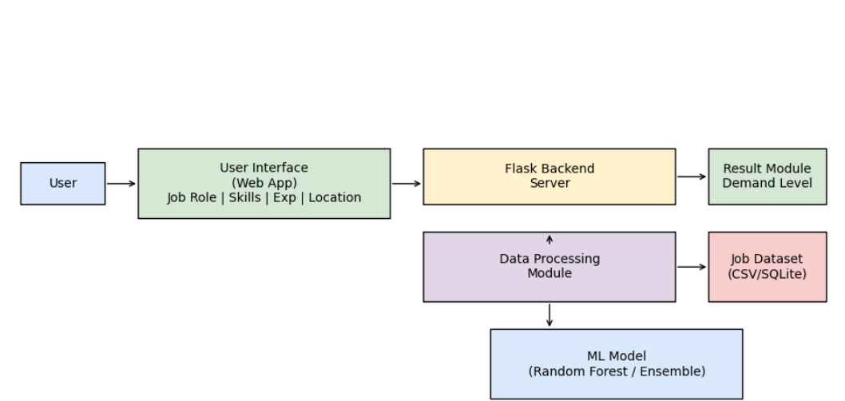
Job demand prediction:

Slide 11
DATA COLLECTION
Collected historical job posting data from online job portals and datasets
Includes job role, required skills, experience level, and job location
Uses posting date and hiring timeline information
Collects time-based data (year-wise and month-wise trends)
Includes industry domain and skill demand information
Derives job demand level from frequency of job postings
Data represents realistic job market and industry hiring trends

Slide 12
METHODOLOGY
The methodology explains the process followed to design and implement the Job Demand Prediction System using machine learning techniques. The system analyzes historical job market data to identify patterns and predict future demand for different job roles.
Data Collection: Historical job posting data is collected, including job role, required skills, experience level, location, and posting date.
Data Preprocessing: The collected data is cleaned by handling missing values, removing duplicates, and filtering irrelevant records.
Feature Engineering: Important features such as skill frequency, experience categories, job domain, and location are extracted and encoded.
Model Training: Machine learning models such as Random Forest and ensemble techniques are trained on the processed dataset.
Model Evaluation: The trained model is evaluated to ensure accurate and reliable job demand predictions.
Prediction & Deployment: The final model is integrated into a Flask-based web application to generate and display job demand predictions.

Slide 13
Step 1: Data Collection
Job market data is collected from online job portals and reliable datasets
Includes job role, required skills, experience level, and job location
Posting date and hiring timeline information are collected
Industry domain and skill requirements are included
Time-based attributes such as year and month are considered
This data represents real-world job market and hiring trends
Step 2: Data Preprocessing
Missing and inconsistent data is identified and cleaned
Duplicate job postings are removed
Categorical values (job role, skills, location) are converted into numerical format
Date and time fields are transformed into useful features
Data is standardized to make it suitable for machine learning
This step ensures the dataset is clean and reliable
Step 3: Feature Engineering
Important features are derived to improve prediction accuracy
Skill frequency and demand indicators are generated
Experience level categories are created
Location-based demand features are included
Time-based demand trends are extracted
Feature engineering helps the model learn job demand patterns effectively

Slide 14
Step 4: Model Selection and Training
A machine learning classification/regression model is selected for job demand prediction
Random Forest and ensemble-based algorithms are used due to their robustness and good performance on structured data
The dataset is split into training and testing sets
The model is trained using historical job market data
Hyperparameters are tuned to improve prediction performance
The trained model learns the relationship between input features and job demand levels
Step 5: Model Evaluation
Model performance is evaluated using standard evaluation metrics
Metrics such as accuracy, precision, recall, and error measures are calculated
Job demand predictions are classified into high demand, medium demand, and low demand
Model performance is validated using unseen test data
This step ensures the model provides reliable and consistent job demand predictions

Slide 15
Step 6: System Integration
The trained machine learning model is integrated into a Flask-based web application
A SQLite / CSV-based dataset is used to store historical job data and prediction results
The backend processes user input received from the web interface
Preprocessed input data is passed to the machine learning model for prediction
Step 7: Prediction and Output Display
User enters job-related details through the web interface
The system processes the input and applies the trained ML model
The machine learning model predicts the job demand level
Influencing factors affecting demand are identified
The predicted results are displayed clearly to the user

Slide 16
IMPLEMENTATION
The implementation phase converts the proposed design and methodology into a fully functional Job Demand Prediction System. The system is implemented using machine learning techniques along with a web-based application to analyze historical job market data and predict future job demand.
Technology Stack Used
Programming Language: Python
Machine Learning Libraries: Scikit-learn (Random Forest / Ensemble Models)
Web Framework: Flask
Database / Dataset Storage: SQLite / CSV files
Frontend Technologies: HTML, CSS, JavaScript
API / External Data: Optional external datasets for market trends
The frontend web interface allows users to enter job-related details such as role, skills, experience, and location. The Flask backend processes this input, applies preprocessing and feature engineering, and sends it to the trained machine learning model. The model predicts the job demand level, and the results are stored and displayed to the user through the web application.

Slide 17
2. Data Handling Implementation
Historical job posting data is loaded using Python
Job-related attributes such as role, skills, experience, location, and posting date are merged
Missing and inconsistent data is cleaned and converted into machine-readable format
Categorical data is encoded and numerical features are standardized
The processed dataset is stored in SQLite / CSV format for further analysis
3. Feature Engineering Implementation
Important features are derived from raw job data
Skill frequency and demand indicators are generated
Experience levels are categorized into meaningful groups
Location-based demand features are created
Time-based features such as monthly and yearly trends are added
These features help the model understand real-world job demand patterns

Slide 18
4. Machine Learning Model Implementation
A machine learning model is implemented for predicting job demand
Random Forest / ensemble-based algorithms are used for better accuracy and stability
The dataset is split into training and testing sets
The model is trained using historical job market data
Hyperparameters are tuned to improve model performance
The trained model is saved for future predictions and deployment
5. Web Application Implementation
The Flask framework is used to connect the frontend and backend components
Users enter job-related details such as role, skills, experience, and location through the web interface
The backend processes the input and sends it to the trained machine learning model
The model generates the predicted job demand level
Prediction results are retrieved and displayed clearly to the user through the web application

Slide 19
EXPERIMENTAL SETUP & RESULTS
Experimental Setup
Hardware: Intel i5 processor, 8 GB RAM, 50 GB storage (64-bit)
Software: Windows / Linux, Python
Tools: VS Code, Jupyter Notebook
ML Libraries: NumPy, Pandas, Scikit-learn
Web & DB: Flask, SQLite
Dataset
Historical job posting records collected from reliable datasets
Attributes include job role, required skills, experience level, location, and posting date
Time-based features such as month-wise and year-wise trends are considered
Job demand level is derived from frequency of job postings
Target Variable: Job Demand Category (High / Medium / Low)
Results
The model successfully identifies job demand trends
Achieved good prediction accuracy (around 80–85%) on test data
Performs consistently across different job roles and locations
Prediction results are generated within a short response time
The system provides reliable insights for career and workforce planning

Slide 20
APPLICATIONS
Helps job seekers understand current and future job demand trends
Assists in career planning and skill development decisions
Useful for students and fresh graduates to choose in-demand roles
Supports recruiters and HR teams in workforce planning
Helps organizations identify skill gaps and hiring needs
Useful for educational institutions to align curriculum with industry demand
Improves overall job market transparency and planning
FUTURE SCOPE
Integration of real-time job posting data from multiple job portals
Use of live market trends for improved prediction accuracy
Development of a mobile application for easy access
Support for more job roles, industries, and locations
Advanced analytics for skill demand forecasting
Integration with career guidance and recommendation systems

Slide 21
CONCLUSION
This project successfully demonstrates the application of machine learning techniques for predicting job demand trends using historical job market data. By analyzing important factors such as job roles, required skills, experience levels, location, and time-based trends, the system provides meaningful insights into current and future employment demand.
The proposed Job Demand Prediction System offers more accurate and data-driven predictions compared to traditional static job analysis methods. The web-based application allows users to easily explore job demand patterns and make informed decisions related to career planning and workforce management.
Overall, the system helps job seekers understand market requirements, assists recruiters in planning hiring strategies, and contributes to improving transparency and efficiency in job market analysis.

Slide 22
Thank you

